Slide 1
Title of the Project –Drag Reduction Of An Ahmed Body With Plasma Actuator
Submitted by,
Devashish Phondani
MASTER OF TECHNOLOGY
(AUTOMOBILE ENGINEERING)
(Roll No. 203705)
Under the guidance of
Dr. Prasanth Anand Kumar Lam
Assistant Professor, MED NIT WARANGAL

Slide 2
INTRODUCTION
The Ahmed body is a simplified three dimensional car model used by researchers in experimental or in numerical simulation to study the aerodynamic flow over the Ahmed body especially how the flow behaves on the rear part of the model due to presence of C-Pillar.
WITHOUT PLASMA ACTUATOR
WITH PLASMA ACTUATOR
WITHOUT PLASMA ACTUATOR
α =35°
STEADY
EVALUATE DRAG COEFFICIENT
AHMED BODY
α =25°
STEADY
BODY FORCE
ELECTRODES
INSULATION
DIELECTRIC MATERIAL
SINGLE DIELECTRIC BARRIER DISCHARGE PLASMA ACTUATOR

Slide 3
LITERATURE REVIEW
AUTHOR | TITLE | CONCLUSION
Devang S. Nath , Prashant Chandra Pujari, Amit Jain and Vikas Rastogi | Drag reduction by application of aerodynamic devices in a race car. | The analysis of the baseline GT with different add on aerodynamic devices was studied by using numerical simulation . The various add –on devices are like Wing, Diffuser. spoiler,. It was found that in the case of GT Spoiler with Diffuser, maximum drag reduction is observed.
Dongri Kim , Hyungrok Do , Haecheon Choi | Drag reduction on a three‑dimensional model vehicle using a wire‑to‑plate DBD plasma actuator. | An ahmed body with wire to plate actuator is analysed experimentally. They compare the mean velocity induced by the wire-to-plate and plate-to-plate plasma actuators with the applied voltage. It was found that the velocity induced for wire to plate is always higher while varying the applied voltage. They also analysed the variations of the drag reduction rate, on the Ahmed body by varying applied voltage and the electrode length. It was found that at l/z=0.8 the drag is reduced by 10 % by using wire to plate plasma actuator at the tip of the slant surface.
Simon Watkins and Gioacchino Vino | The effect of vehicle spacing on the aerodynamics of a representative car shape | In the research done by Simon Watkins and Gioacchino Vino on two Ahmed body in wind tunnel testing to find out the drag reduction and the nature of flow structures and wake formation when the distance between the two vehicle is varied. The Ahmed bodies having back slant angle 30° were taken and the test speed was 35 m/s . They found the time averaged drag coefficient variation for front, rear and isolated model of Ahmed body with the inter vehicle gap and the wake pattern visualization at the different inter vehicle gap.

Slide 4
LITERATURE REVIEW
Chenguang Lai ,Hang Fu Bo Hu , Zhiwei Ling and Li Jiang | Aerodynamic Drag Reduction and Optimization of MIRA Model Based on Plasma Actuator | They represents the application of single dielectric barrier plasma actuators on the rear of notch back car. They have done the simulation study having plasma actuator model on the rear of the car at four different location like, the rear end of the roof, c-pillar, upper and side of the trunk to study the flow structures and control over flow separation behind the car when plasma actuator is on separately or simultaneously. They studied the effect of input voltage on coefficient of drag and found that at 15kv, the drag coefficient is reduced( upto 5.35%) when compared with base model (cd = 0.32) in case when plasma actuator was employed at side of the trunk.
WangHanfeng a,b, ZhouYu c, ZouChao a, HeXuhui a,b, | Aerodynamic drag reduction of an Ahmedbody based on deflectors | The numerical simulation is done on ahmed body with deflectors to improve the aerodynamic drag. It was also found that the aerodynamic drag is highly depends on the slant angle. When α <= 12.5° ,the flow is completely attached to the rear slant surface and a pair of longitudinal vortices were found in the near wake region. When 12.5° <α < 30° where the coefficient of drag will increase with slant angle as the flow over the slant and back of the Ahmed body becomes more 3 dimensional and the longitudinal vortices becomes much more stronger. When α = 30° the flow at the top of the roof separates and it reattaches on the slant surface and hence forming a separation bubble at the slant surface.
Y. B. Suzen, P. G. Huang, J. D. Jacob | Numerical Simulations of Plasma Based Flow Control Applications | In the research done by Y.B Suzen et al, developed the mathematical model to simulate the plasma actuator. The effect of plasma actuator computationally was added as body force term (N/m^3) in the Navier Stokes Equation. The body force which is produced by the plasma actuator on the surrounding air flow, is a product of two terms:- Charge Density C/m³ and Electric Field N/C

Slide 5
Literature Gap
Many experimental research has been going on plasma actuator to increase its effectiveness However, to decrease the drag by employing the body force on Navier stokes equation to model plasma actuator on Ahmed body is a special scenario that needs to be explore.
Aim
The aim of the project is to analyse the effectiveness of aerodynamic plasma actuators as a means of active flow control over a Ahmed Body. In this study, a numerical simulation is done on Ahmed Body with Slant angle of α =25° and 35° without plasma actuator model and with Plasma actuator on Ahmed Body with slant angle 35° at the rear end of the Ahmed body to control the drag acting on the body. An optimization is done with area of plasma actuator to know how the flow structure will behave behind the Ahmed body
Objectives
1- To estimate the Drag Coefficient on Ahmed body for the Slant angle α =25° and 35° with the help of numerical Simulation and by Performing Grid Independence Test.
2- To Develop the User Defined Function Code to model the Plasma Actuator.
3- To estimate the Velocity Profile over the slant Surface and Wake Zone in a direction perpendicular to flow velocity with or without Plasma Actuator.
4-To estimate the Drag Coefficient over the Ahmed body with Plasma actuator model.
5- To Plot the variation of coefficient of drag with back slant angle.

Slide 6
GEOMETRY OF AHMED BODY
SIDE VIEW
30 mm
FRONT VIEW
389 mm
L=1044 mm
α
R= 100 mm
288 mm
L= 201.2 mm
L= 50 mm
L=202 mm
L=470 mm
327 mm
L=389 mm
L=327 mm
BOTTOM VIEW

Slide 7
Computational Domain in Plan View
7000 mm
U
2000 mm
2000 mm 5000 mm
Computational domain in plan view. The inlet, outlet, top and the lateral boundaries of the computational domain extend 2 m, 5 m, 2 m and 2 m, respectively, from the origin.

Slide 8
Computational Domain Boundary Conditions
1
Boundary No. | Boundary Name | Boundary Condition
1 | Inlet | Velocity Inlet Boundary
2 | Outlet | Pressure Outlet
3 | Symmetry1 | Symmetry Boundary
4 | Symmetry-Top | Symmetry Boundary
5 | Symmetry- Side | Symmetry Boundary
6 | Street | No Slip Boundary
7 | Ahmed Body | No Slip Boundary
7
4
3
5
6
2

Slide 9
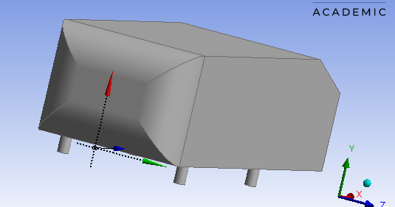
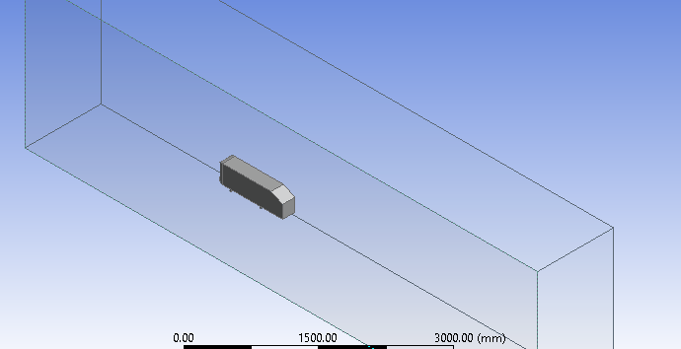
Computational Domain
Ahmed Body
DIMENSIONS | (mm)
LENGTH | 1044
WIDTH | 389
HEIGHT | 288
LENGTH OF BACK SLANT | 222

Slide 10
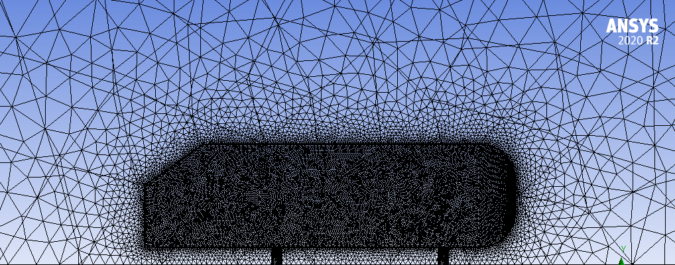
MESH
Ahmed Body

Slide 11
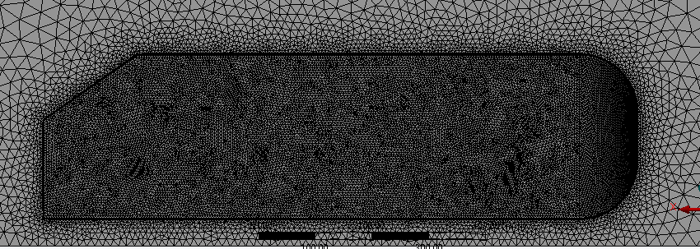
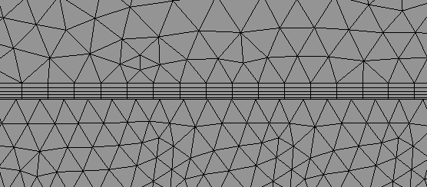
Inflation Layer
Ahmed Body
Inflation Layers

Slide 12
GRID INDEPENDENCE TEST FOR AHMED BODY
MESH OPERATION
RESULT
Number Of Grid Elements | Face Sizing | Body Sizing | Inflation Layers/First Cell Height / Y+ | Coefficient Of Drag | Turbulence Model | Convergence Criteria
483556 | 7.5 mm | 423.08 mm | 5 / Automatic Programmed Control | 0.30273 | K-epsilon | None
1104085 | 6.5 mm | 380 mm | 5 / 0.6 mm / 50 | 0.29292 | SST-KW | None
1465776 | 5 mm | 300 mm | 5 / 0.48 mm / 40 | 0.29846 | SST-KW | None
For α = 25° and U =30 m/s
Material Medium - Air | Density = 1.225 kg/(m³) | Dynamic Viscosity - 1.7894×10⁻⁵ kg/(ms)

Slide 13
GRID INDEPENDENCE TEST FOR AHMED BODY
MESH OPERATION
RESULT
Number Of Grid Elements | Face Sizing | Body Sizing | Inflation Layers/First Cell Height / Y+ | Coefficient Of Drag | Turbulence Model | Convergence Criteria
483556 | 7.5 mm | 423.08 mm | 5 / Automatic Programmed Control | 0.2936 | K-epsilon | None
654025 | 6.5 mm | 380 mm | 5 / 0.6 mm / 50 | 0.3037 | SST-KW | None
1051369 | 5 mm | 300 mm | 5 / 0.48 mm / 40 | 0.3011 | SST-KW | None
1402919 | 4.3 mm | 250 mm | 5 / 0.42 mm / 35 | 0.30008 | SST- kw | None
For α = 35° and U =30 m/s
Material Medium - Air | Density = 1.225 kg/(m³) | Dynamic Viscosity - 1.7894×10⁻⁵ kg/(ms)

Slide 14
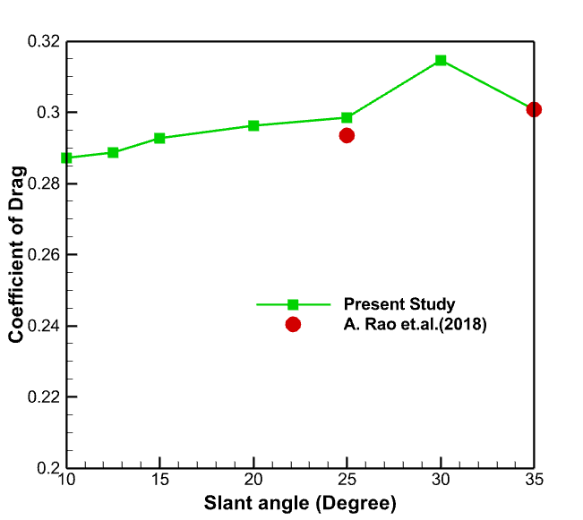
VALIDATION OF AHMED BODY
Ahmed body Geometric and flow condition | Present Study | Validation
At α = 25° & U =30m/s | C_{d} = 0.29846 | C_{d} = 0.29350
At α = 35° & U =30m/s | C_{d} = 0.30008 | C_{d} = 0.3007
Journal name- Journal of wind Engineering and Industrial Aerodynamics.
Title- On the two flow states in the wake of a hatchback Ahmed Body.
Authors – A.Rao, G. Minelli , B.Basara, S.krajnovic (2018)

Slide 15
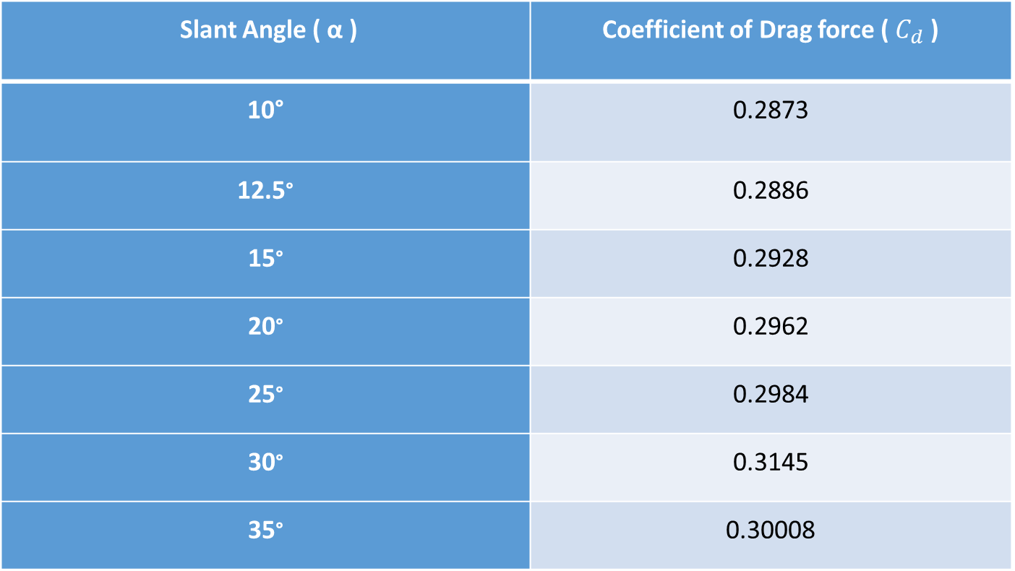
Variation of Coefficient of drag force with back slant angle (α) at $U_{∞}$= 30m/s
Slant Angle ( α ) | Coefficient of Drag force ( $C_{d}$ )
10° | 0.2873
12.5° | 0.2886
15° | 0.2928
20° | 0.2962
25° | 0.2984
30° | 0.3145
35° | 0.30008

Slide 16
Variation of velocity in x direction along the lines shown below at $U_{∞}$ =40 m/s, α = 35°
Y- Coordinate
X- Coordinate
Y at X=0.931m
Y at X=0.981m
Y at X=1.031m
Y at X=1.181m

Slide 17
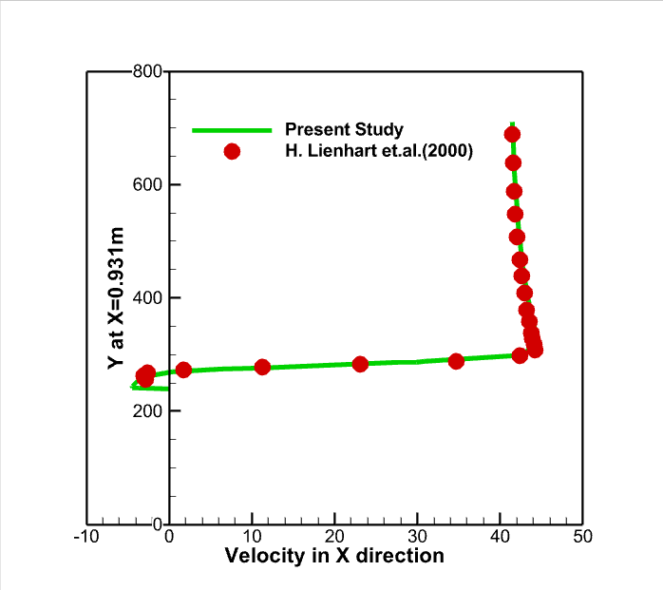
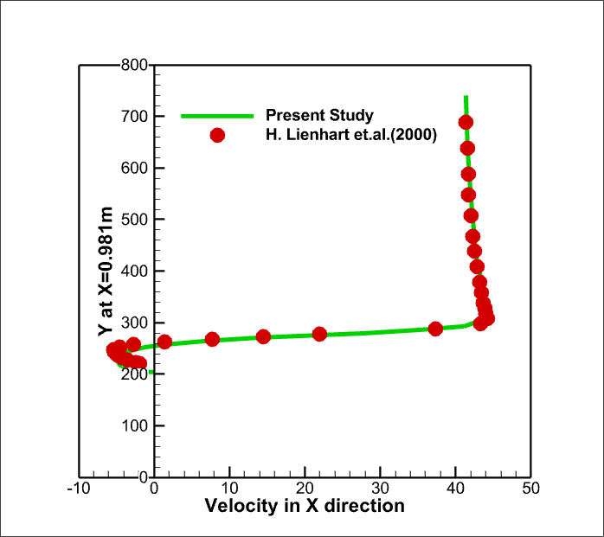
Variation of velocity in x direction along the lines X= 0.931m and X=0.981m

Slide 18
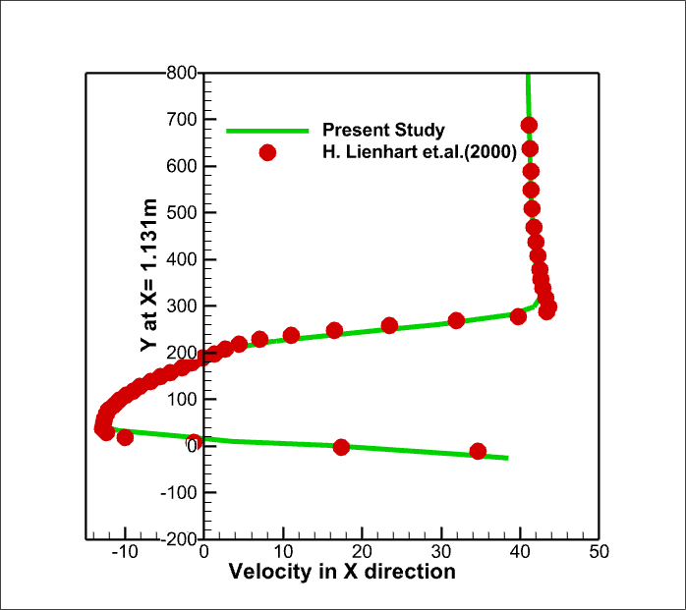
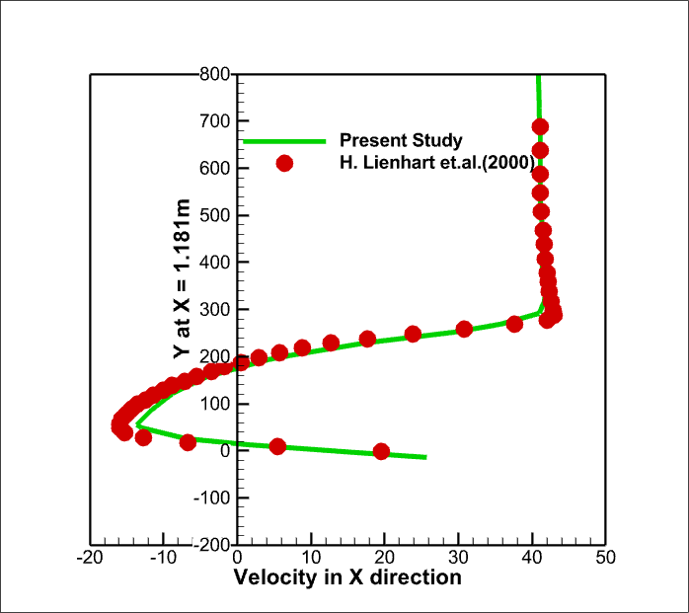
Variation of velocity in x direction along the lines X= 0.931m and X=0.981m

Slide 19
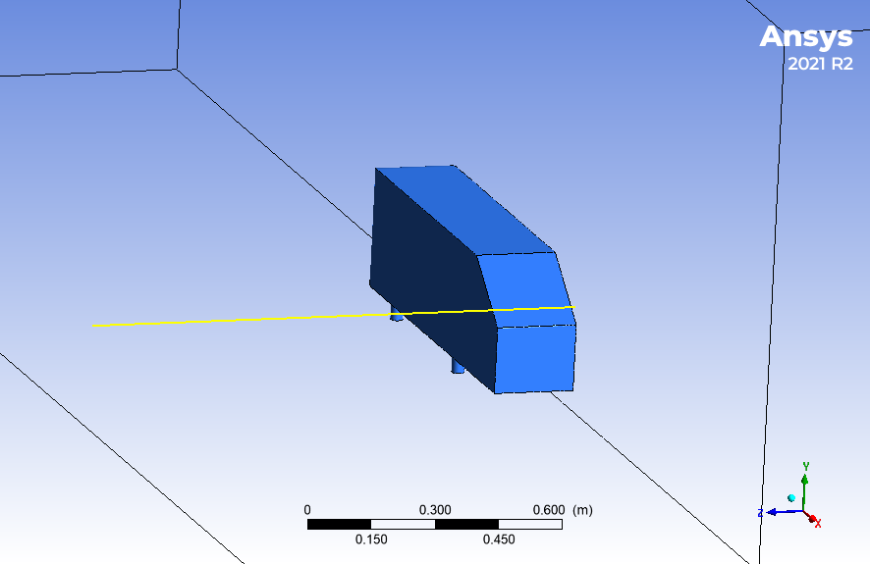
Coefficient of Pressure ($C_{p}$) Plot at $U_{∞}$ = 40m/s and α=35 ̊
The line has been drawn above the slant surface of Ahmed body at X =1.03 m with different values of Y coordinate like 190.8mm, 260mm, 280 mm.
Z at Y = 280mm
Z at Y = 260mm
Z at Y = 190.8mm

Slide 20
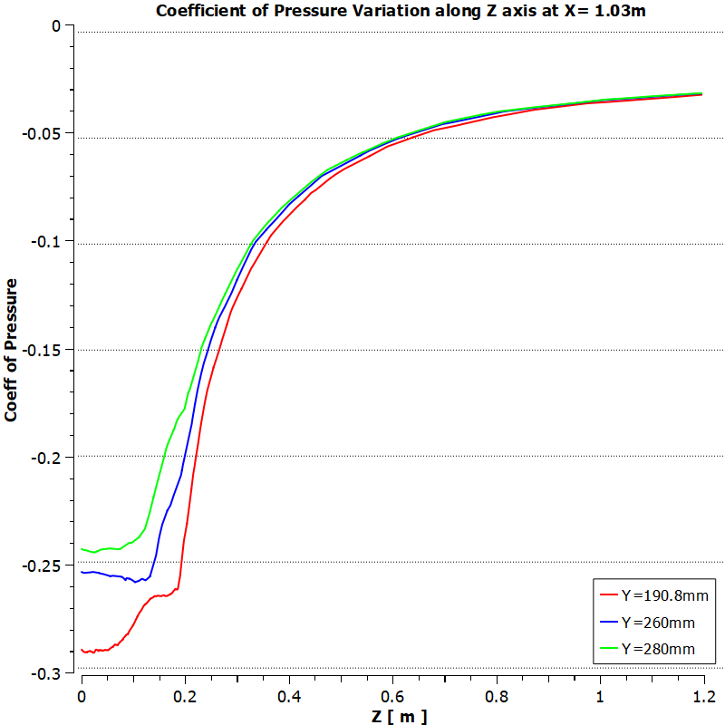

Slide 21
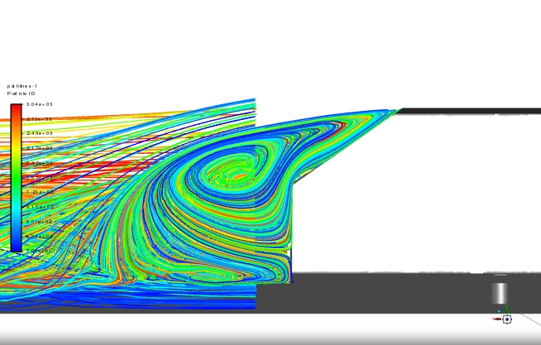
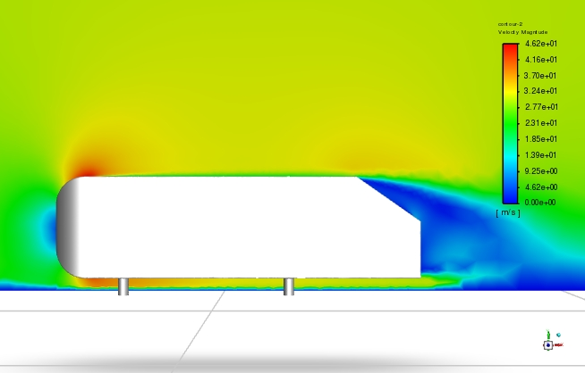
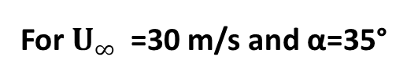
Contour Plots
For $U_{∞}$ =30 m/s and α=35°
Velocity Magnitude Contour
Path lines

Slide 22
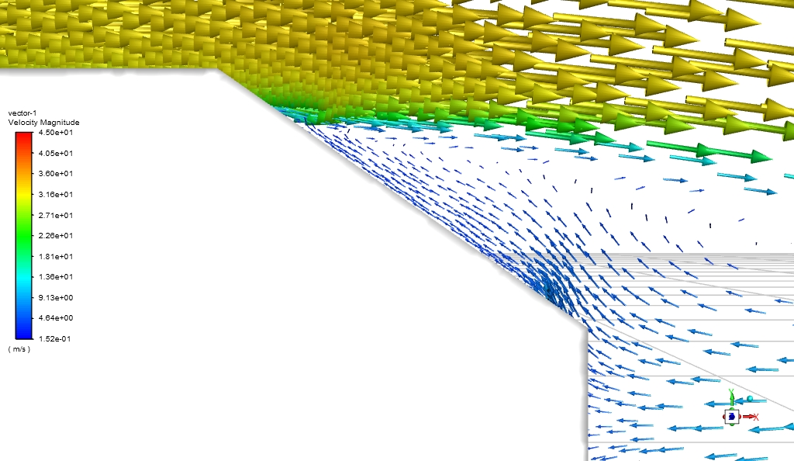
Flow Separation at the tip of the roof

Slide 23
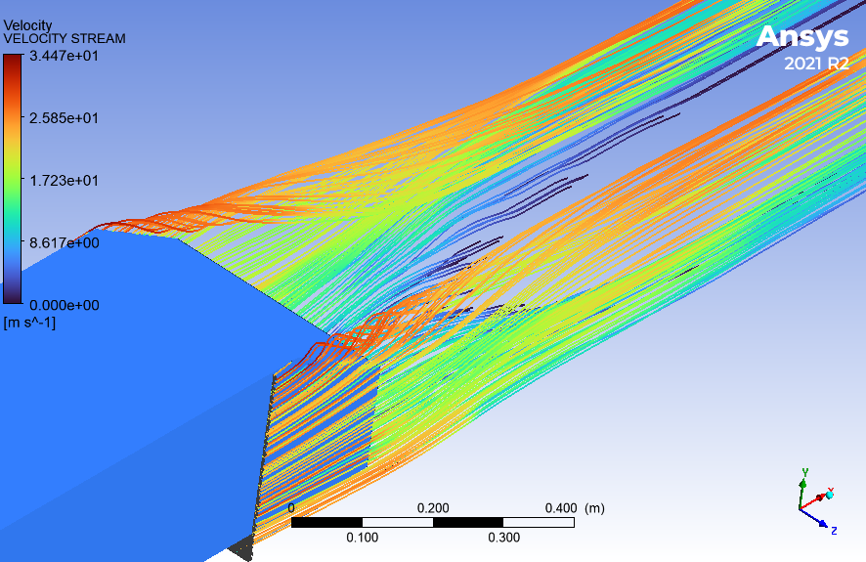
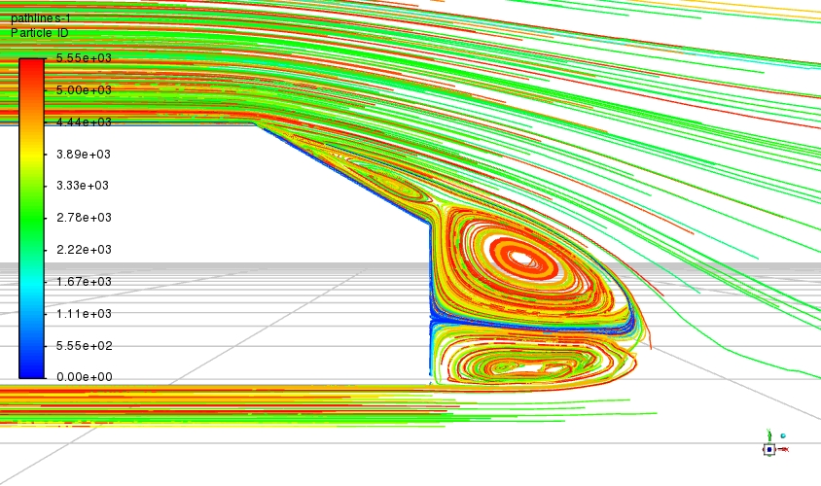

Contour Plots
For $U_{∞}$ = 30m/s and α =30°
Path lines at C-Pillar Vortices Path Lines

Slide 24
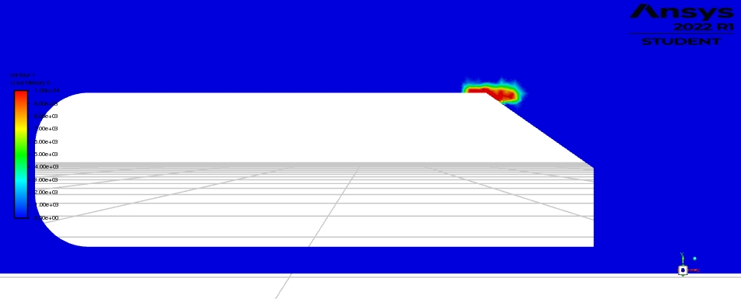
Contour Plots
Contour plot for location of Plasma actuator at α= 35°

Slide 25
User Defined Code To Model Plasma Actuator
#include "udf.h" //udf library in C language
DEFINE_SOURCE(plasma_source, c, t, dS, eqn) //define macro
{
#if !RP_HOST
real xc[ND_ND];
real source, x, y,z;
C_CENTROID(xc, c, t);
x = xc[0];
y = xc[1];
z = xc[2];
#if RP_NODE
if ((x > 0.8) && (y > 0.27) && (z > 0) && (x < 0.9) && (y < 0.3) && (z < 0.1945)) // Plasma Region
{
source = 10000.0; // Value of Plasma Source
dS[eqn] = 0;
}
else
{
source = 0;
dS[eqn] = 0;
}
C_UDMI(c, t, 0) = source;
#endif
return source;
#endif
}

Slide 26
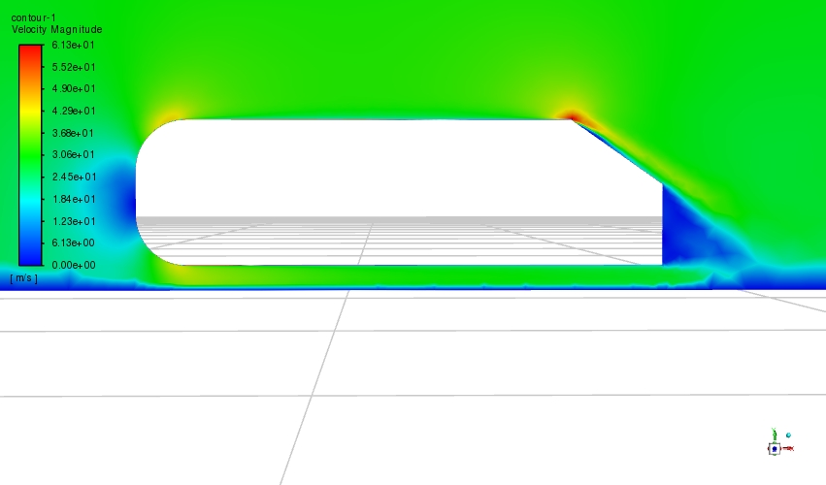
Contour Plots
Velocity Magnitude contour for Plasma Actuator at α= 35° and $U_{∞}$ =30 m/s ( Plasma Source= 10000 N/m³) )

Slide 27
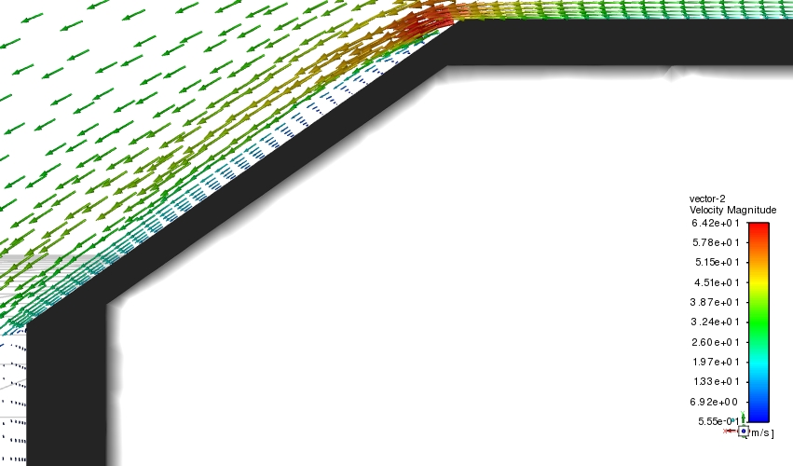
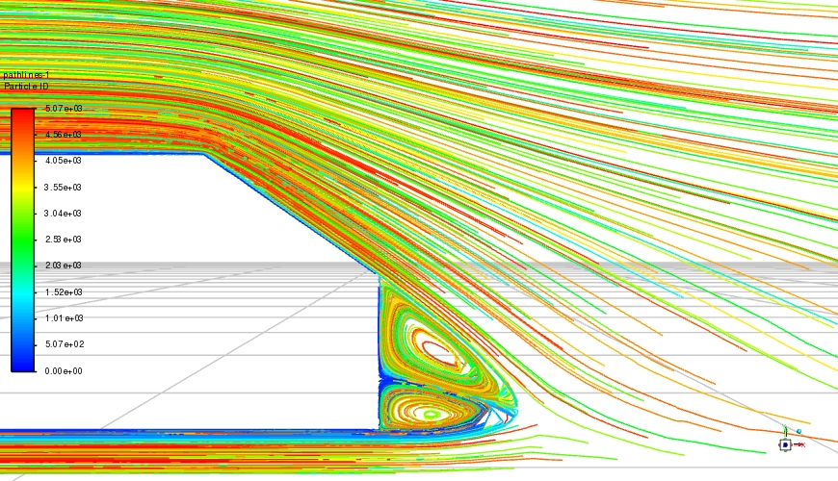
Contour Plots
Vector Plot at $U_{∞}$ =30m/s and α =35° with Plasma Model Path lines at${ U}_{∞}$ =30m/s and α =35° with Plasma
Model

Slide 28
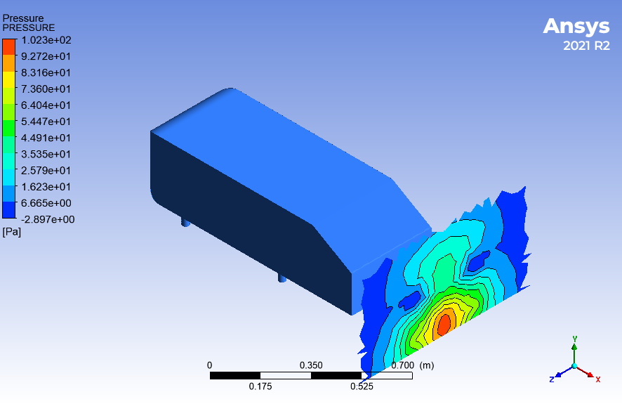
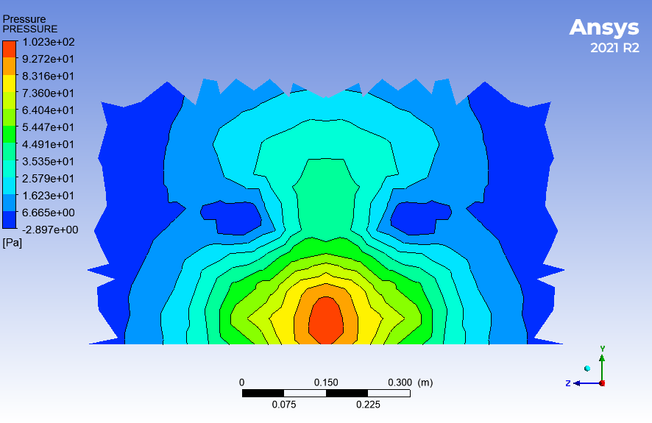
Pressure contours behind the Ahmed body at X= 1.3m For $U_{∞}$= 30m/s and α=30° without Plasma Model

Slide 29
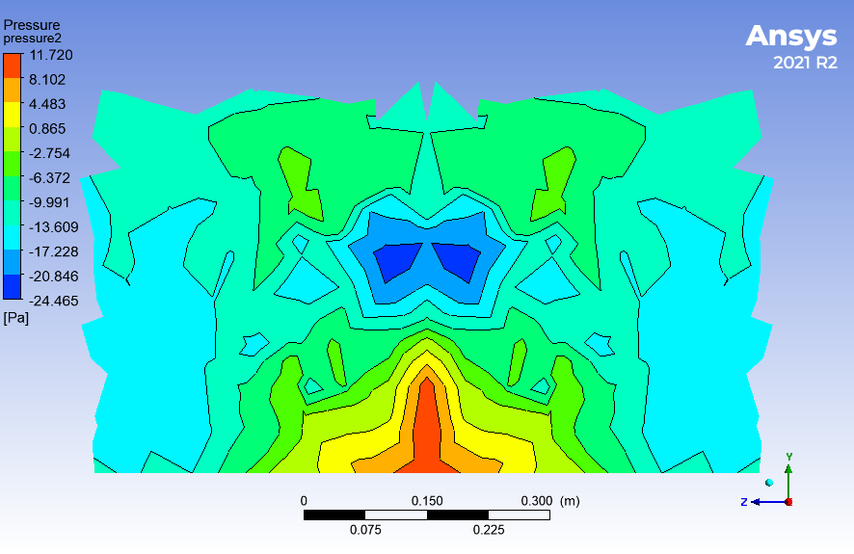
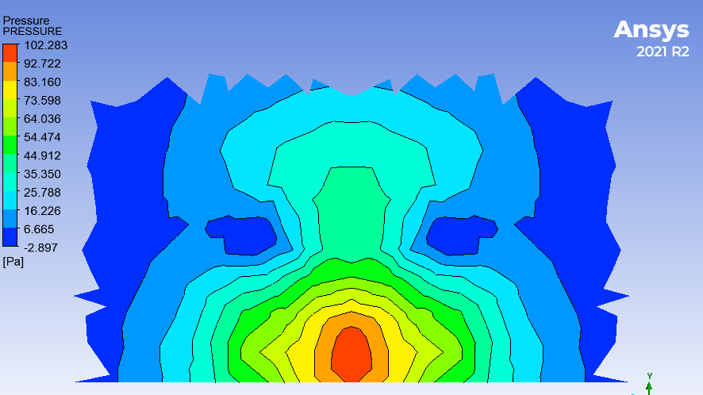
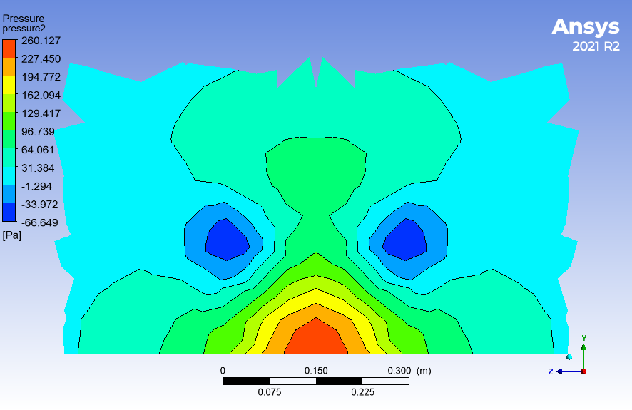
Pressure contours behind the Ahmed body at X= 1.3m
For $U_{∞}$= 30m/s and α=35° without Plasma Model For $U_{∞}$ = 30m/s and α=30° without Plasma Model
for $U_{∞}$ = 30m/s and α=35 ̊ with Plasma Source ( 10000 N/m³)

Slide 30
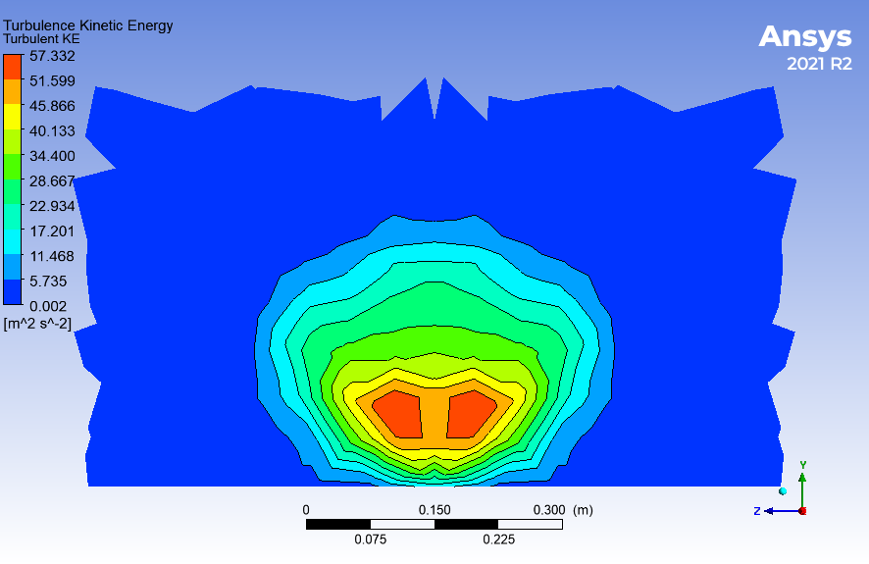
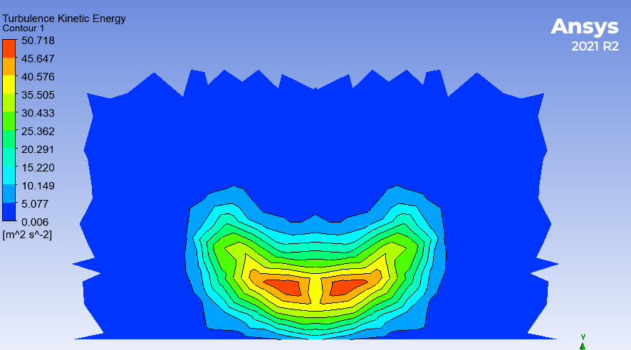
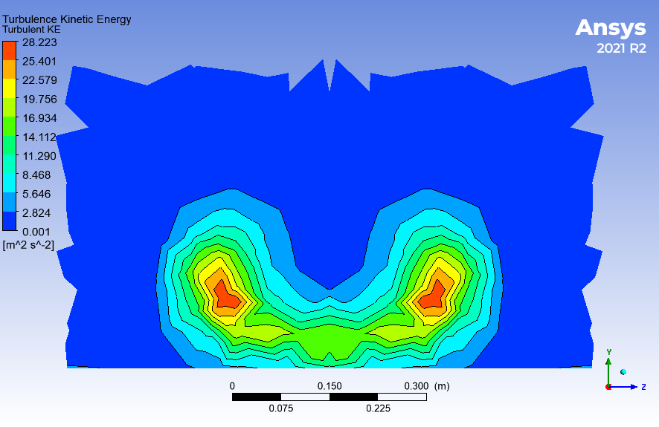

Turbulent Kinetic energy
For $U_{∞}$ = 30m/s and α =35° without Plasma Model
for $U_{∞}$= 30m/s and α =30° without Plasma Model
For $U_{∞}$ = 30m/s and α =35° With Plasma Model (Plasma Source = 10000 N/m³)

Slide 31
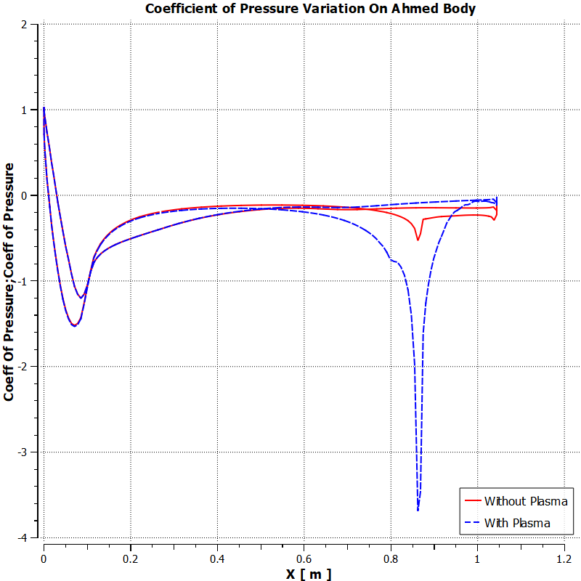
Coefficient of Pressure with and without Plasma Actuator at α=35 ̊ and $U_{∞}$=30m/s ( Plasma Source =10000 N/m³ )

Slide 32
Pressure coefficient and viscous coefficient breakdown at α=35 ̊ and $U_{∞}$ =30m/s
 | Plasma Source(N/m³) | Pressure Coefficient | Viscous Coefficient | C_{d}
Without Plasma | 0 | 0.24618 | 0.04749 | 0.29367
With Plasma | 10000 | 0.34933 | 0.05398 | 0.40331
Here the drag is increased due to increase in coefficient of pressure , hence there is need of optimization of plasma region with plasma source magnitude.

Slide 33
Comparison of Aerodynamic drag for different thickness of plasma region with same width at $U_{∞}$= 30m/s & α =35°
S.NO | Plasma Source(N/m³) | Thickness(mm) | C_{d}
1 | NO | 0 | 0.2936
2 | 100 | 2 | 0.2818
3 | 150 | 2 | 0.2937
4 | 100 | 1 | 0.2925
Comparison of Pressure coefficient and Viscous Coefficient with Plasma source =100 N/m³
 | Plasma Source( N/m³ ) | Pressure Coefficient | Viscous Coefficient | C_{d}
Without Plasma | 0 | 0.24618 | 0.04749 | 0.29367
With Plasma | 100 | 0.23286 | 0.04898 | 0.2818

Slide 34
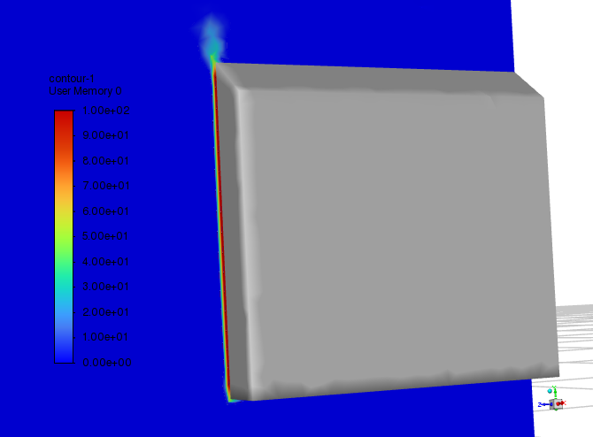
Plasma actuator modeled on vertical back surface for $U_{∞}$ = 30m/s and α =35° With Plasma Model
S.NO | Plasma Source(N/m³) | Width(mm) | Thickness(mm) | C_{d}
1 | NO | 0 | 0 | 0.2936
2 | 100 | 70 | 2 | 0.2981
3 | 200 | 50 | 3 | 0.2937
4 | 500 | 50 | 3 | 0.2765
Contour Plot for Plasma actuator model Location
at vertical base surface

Slide 35
REFERENCES
1- Drag reduction by application of aerodynamic devices in a race car - Devang S. Nath , Prashant Chandra Pujari, Amit Jain and Vikas Rastogi
2- Drag reduction on a three‑dimensional model vehicle using a wire‑to‑plate DBD plasma actuator -Dongri Kim , Hyungrok Do , Haecheon Choi
3-Aerodynamic drag reduction investigation for a simplified road vechile using Plasma flow control - Bahram Khalighi, Joanna Ho, John Cooney, Brian Neiswander, Thomas C. Corke, Taeyoung Han
4- Ansys Fluent Customization Manual
5-On the two flow states in the wake of a hatchback Ahmed body- A. Rao , G. Minelli , B. Basara , S. Krajnovic.
6- Aerodynamic drag reduction and optimization of MIRA model based on Plasma actuator By Chenguang Lai ,Hang Fu Bo Hu , Zhiwei Ling and Li Jiang
7. Aerodynamic drag reduction of an Ahmed body based on deflectors By Dongri Kim , Hyungrok Do , Haecheon Choi
8. Numerical Simulations of Plasma Based Flow Control Applications By Y. B. Suzen, P. G. Huang, J. D. Jacob
9. On the two flow states in the wake of a hatchback Ahmed Body By A.Rao, G. Minelli , B.Basara, S.krajnovic
10. Novel Multi-Barrier Plasma Actuators for Increased Thrust by Ryan Durscher and Subrata Roy
e Salient Features of the Time – Averaged Ground Vehicle Wake.
Salient Features of the Time – Averaged Ground Vehicle Wake.

Slide 36
11. The effect of vehicle spacing on the aerodynamics of a representative car shape By Simon Watkins and Gioacchino Vino
12. Aerodynamic drag reduction and flow control of Ahmed body with flaps By Jie Tian, Yingchao Zhang, Hui Zhu and Hongwei Xiao
13. Single and multi - DBD plasma actuators based on wire HV electrode By A. Debien, N.BenardP, E. Moreau
14. Some salient features of the time-averaged ground vehicle wake By Ahmed SR, Ramm R and Faltin G. SAE paper 840300, 1984.

